Slide 1
Reinforcement Tableau Project
E-Commerce Sales Analysis
Presented by
ARJUN.M
Total Discount
Sales
Profit

Slide 2
Project Overview This Tableau project analyzes e-commerce sales performance using various KPIs, market trends, and profit insights. It includes multiple worksheets and dashboards to visualize different dimensions such as Profit, order Quantity and sales trends.

Slide 3
Category Wise YTD Vs PYTD Sales
Compares Year-To-Date (YTD) sales with Previous Year-To-Date (PYTD) by product category
Market Share by Sales
Visualizes sales distribution across different market segments.

Slide 4
KPI Used in Project
Order Quantity KPI
Shows key performance indicators related to order quantities.
Profit KPI
Details sales or profit analysis using Tableau visualizations.
Sales KPI
High-level key performance indicators tracking sales performance.

Slide 5
Dashboards and Stories
Dashboard : An integrated view of key sales and profit metrics.
Story : A guided narrative combining multiple views for business insights.

Slide 6
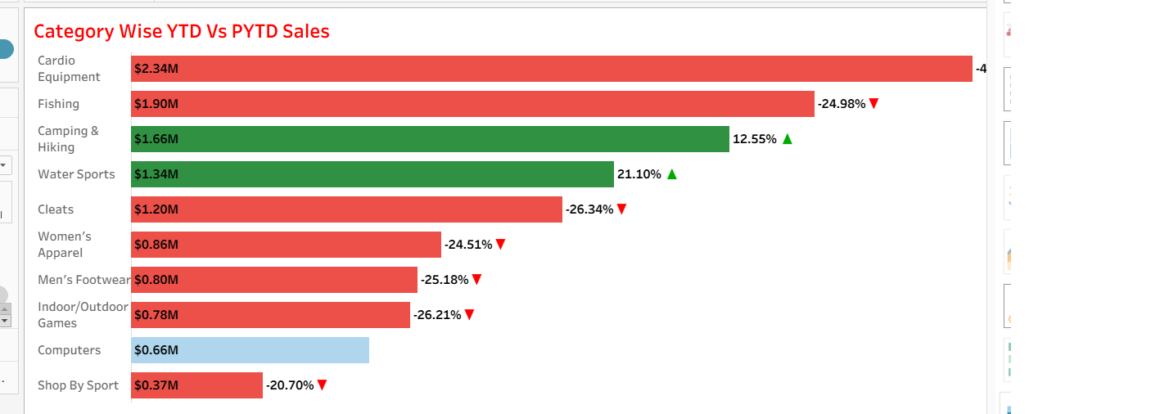
Category wise sales Comparison between last year and current year
It’s help to understand the sales between 2 years

Slide 7
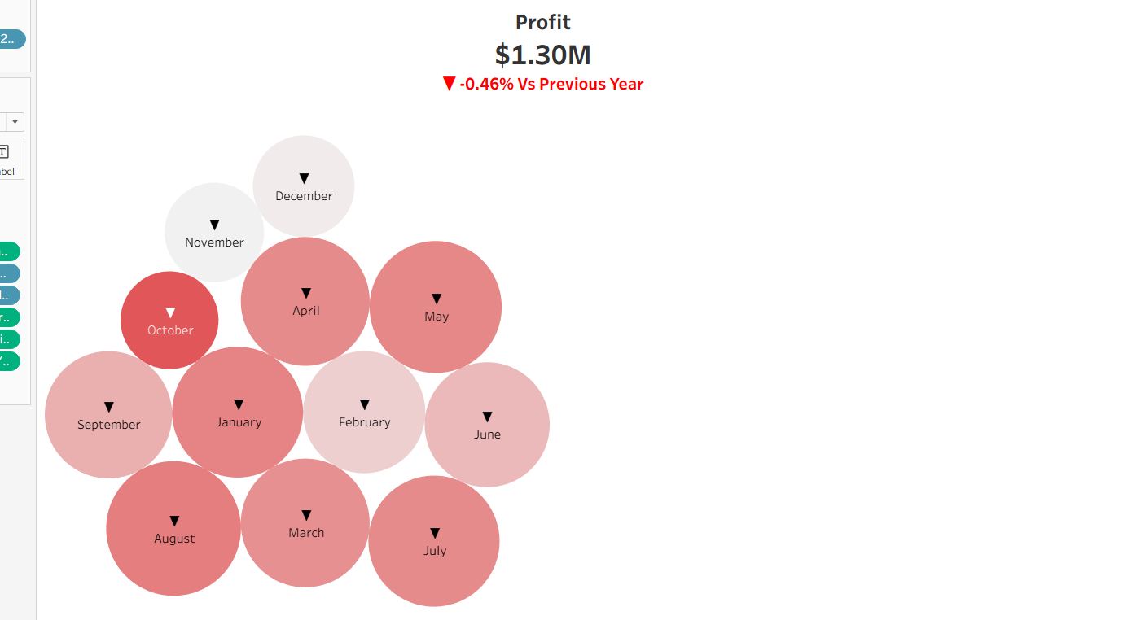
Profit Month wise
Monthly view of profit trends and seasonality.

Slide 8
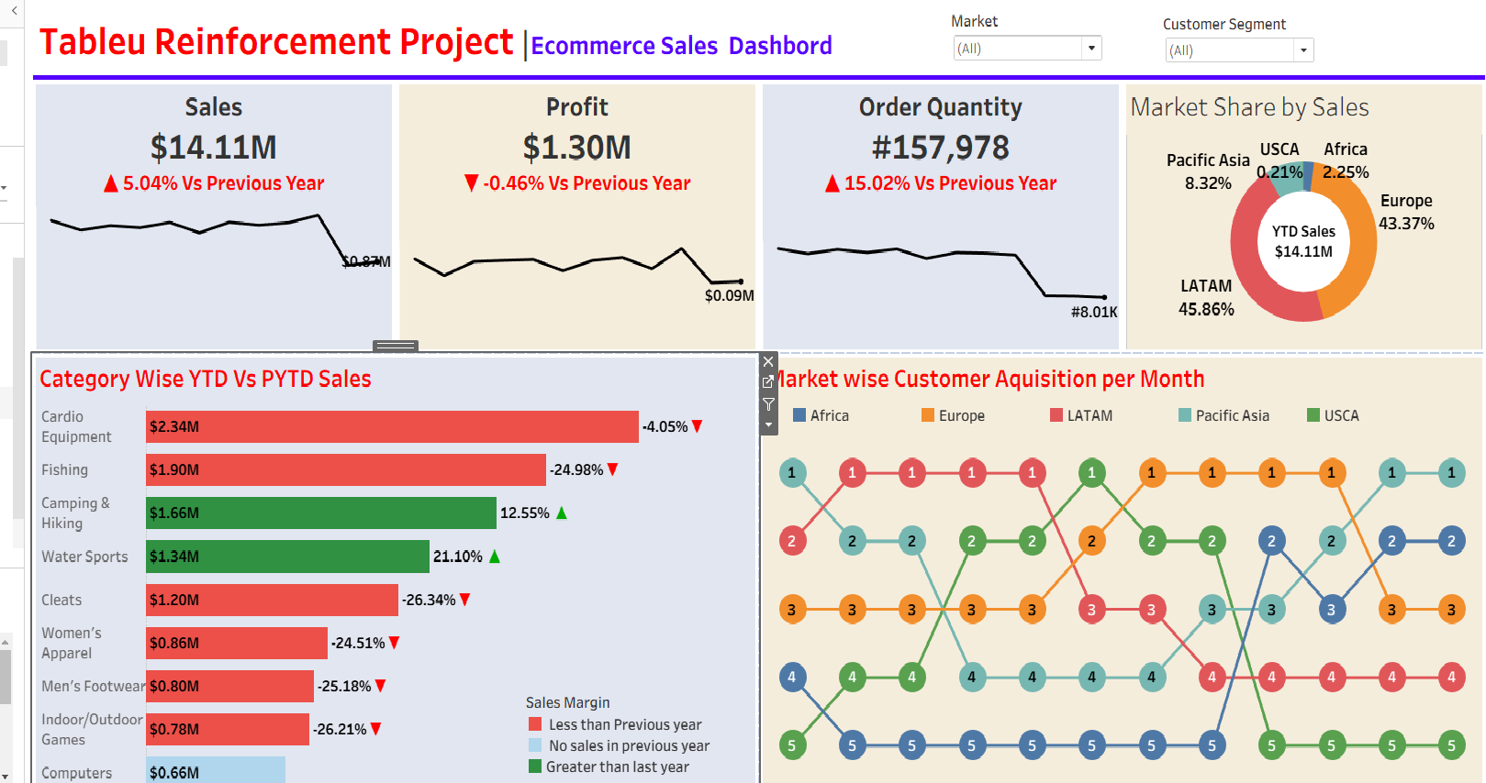
Dashboard
An integrated view of key sales and profit metrics.

Slide 9
Thank you

